Slide 1

Corona virus prediction
BY:
Sai Krupa Peraka
Sai Nishanth Adingi

Slide 2

Content
Model Implementation
Dataset
Testing
Prediction
Conclusion

Slide 3
Model Implementation
Rolling statics Technique
Dickey Fuller test
Estimate trend
Moving Average and Auto Regression
Differencing
ARIMA
Prediction

Slide 4
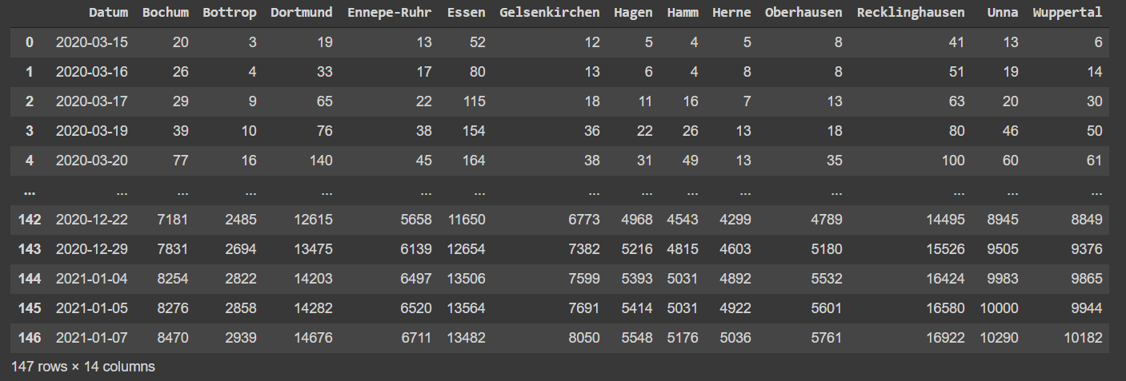
Dataset

Slide 5
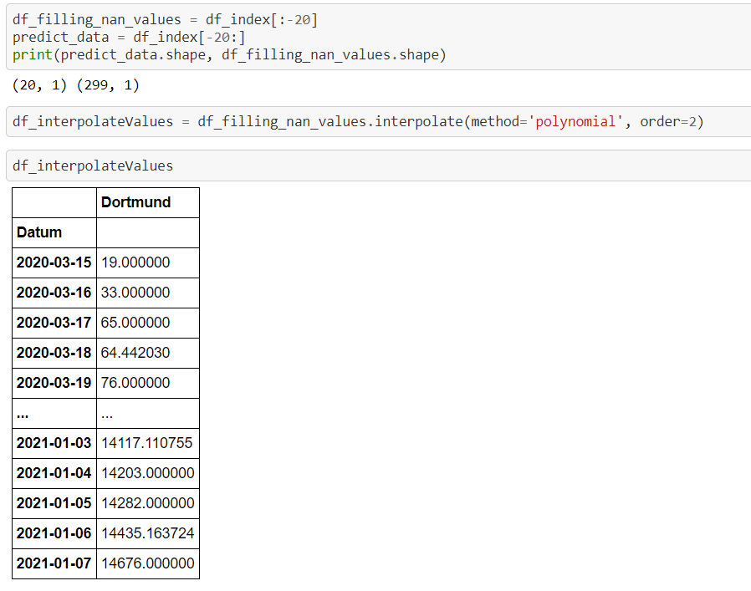
Fill missing values using Data frames

Slide 6
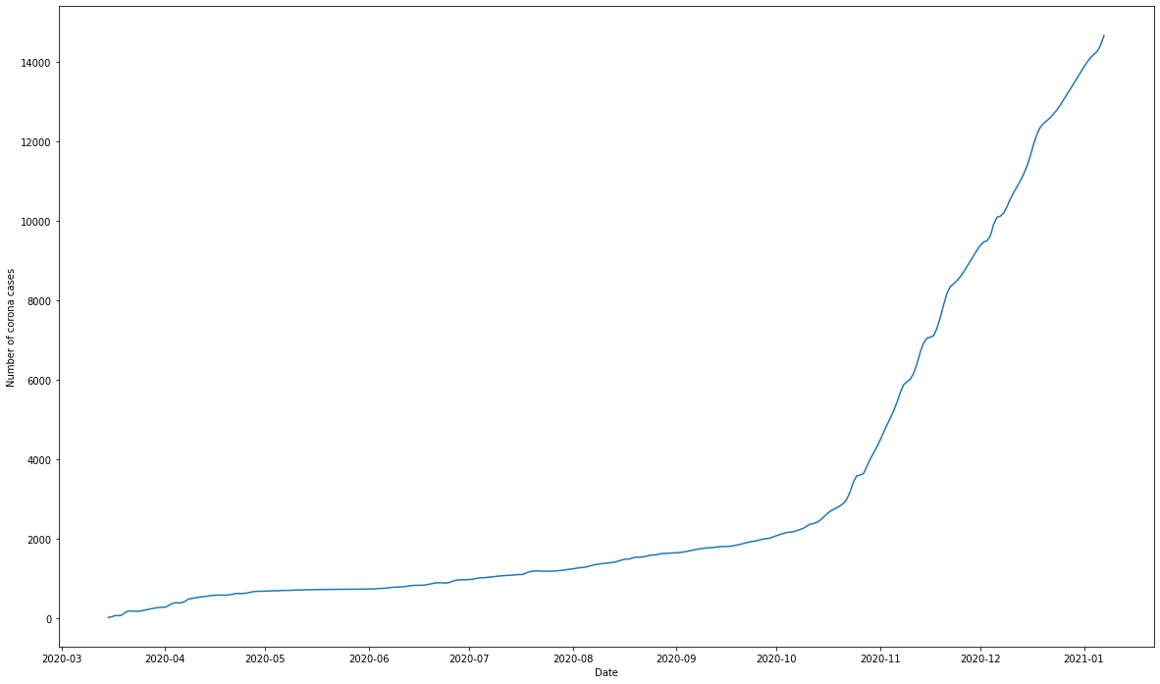

Slide 7
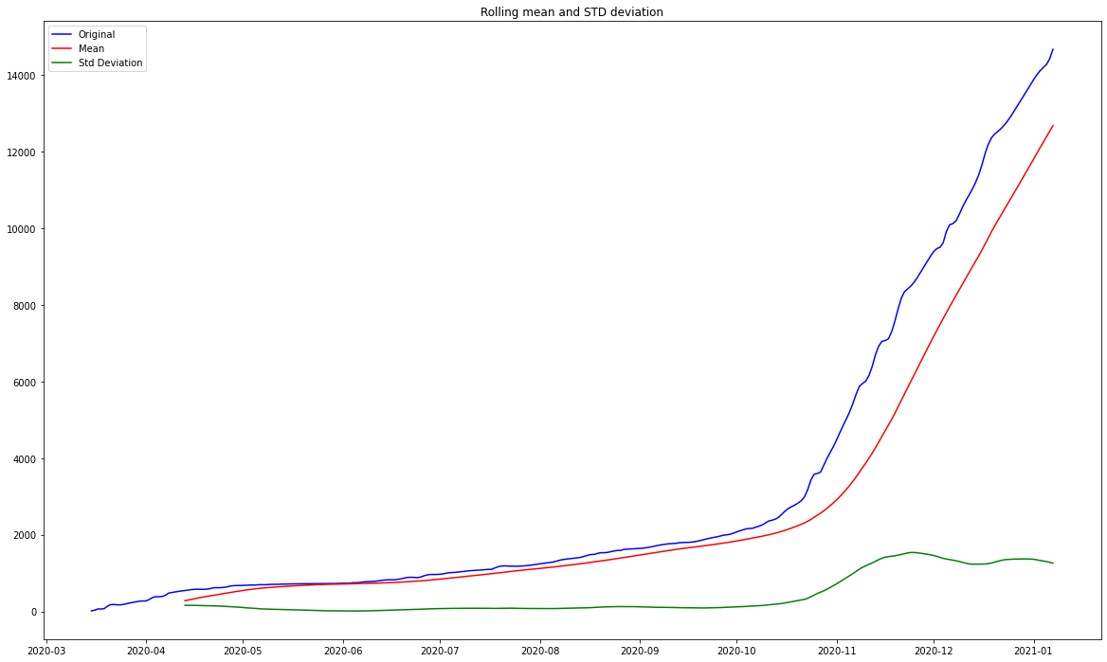
Rolling statics Technique

Slide 8
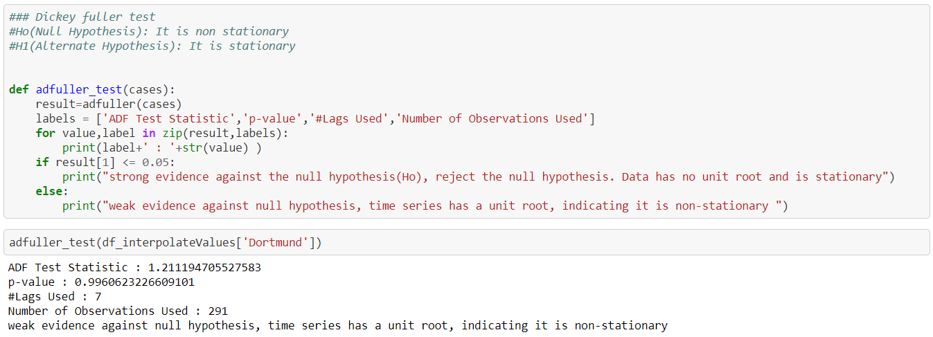
Dickey Full Adder Test
Here we are check the stationarity of the data
Null hypothesis say p-value should not be more than 0.05

Slide 9
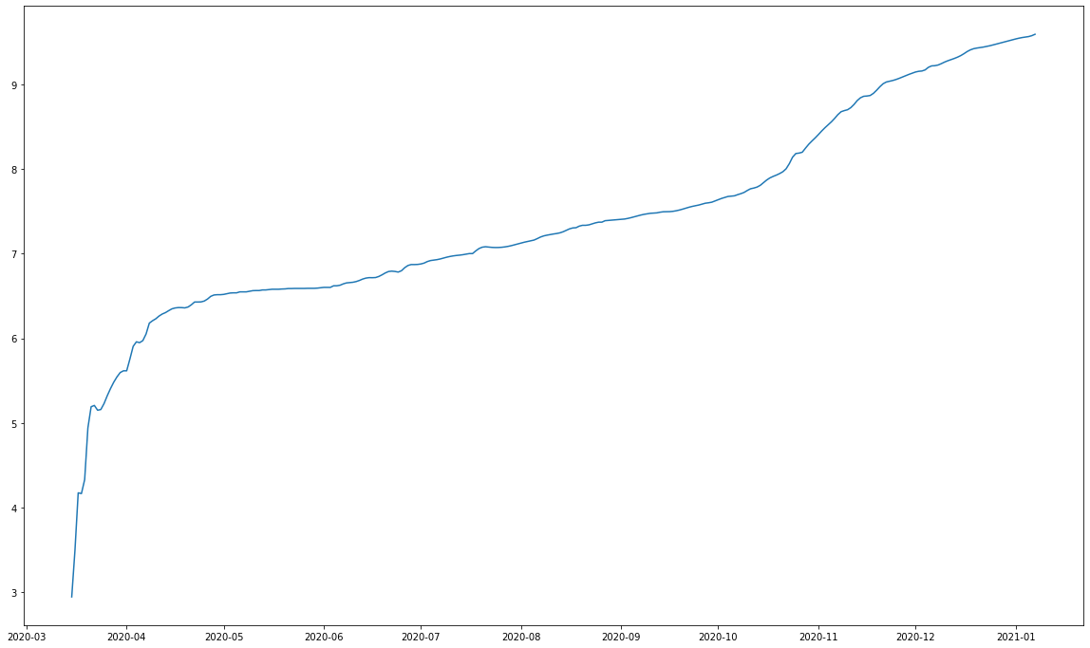
Estimate Trend
Taking the logarithms of the dataset

Slide 10
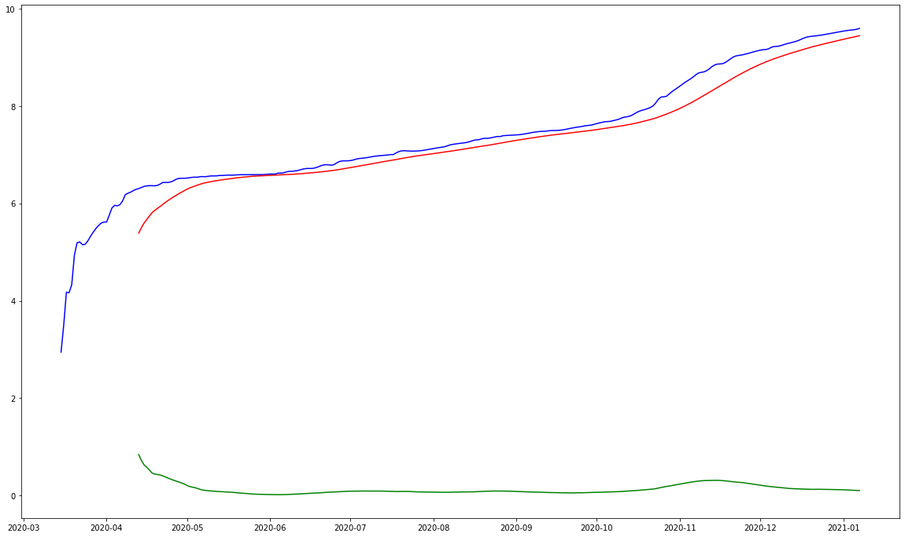
Moving average and Auto Regression
We Calculated the moving average after transforming the data to log scale.

Slide 11
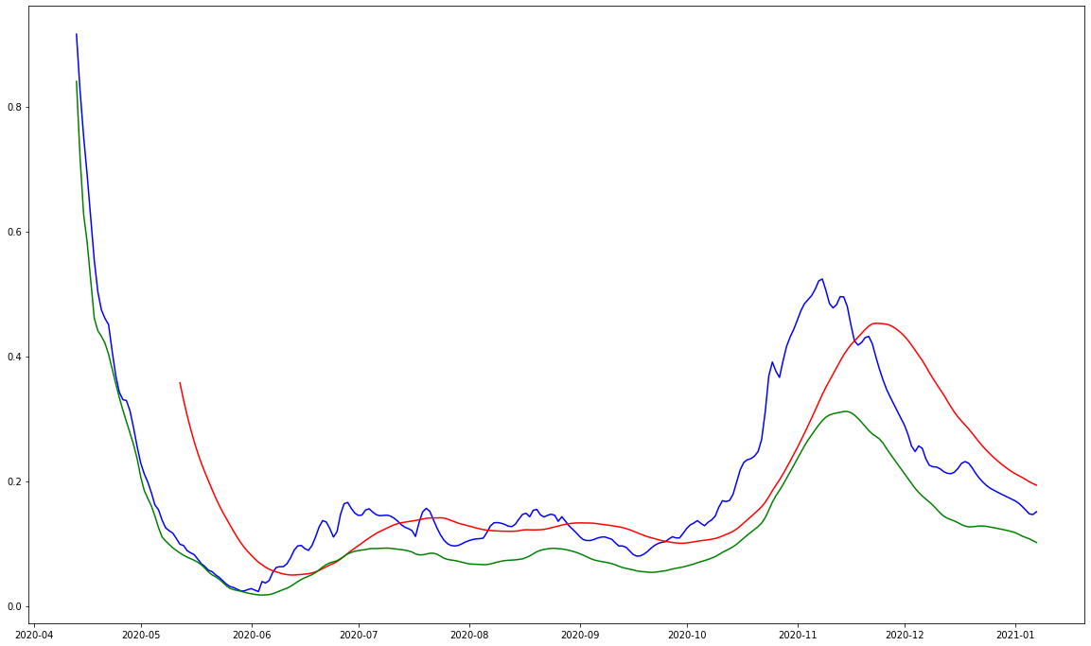
Transformations
Since Data is still not stationary, we are subtracting the moving average from log scale values
So, there are other methods to make data stationary as well like square root, cube root and all, here we have considering log scale.
Sometimes this also depends upon the data.

Slide 12
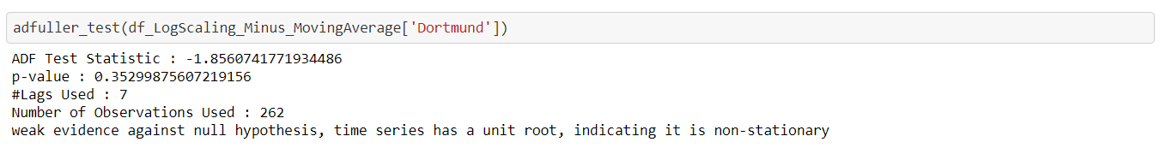
Dickey Fuller test
Once again checking for the stationarity using Dickey fuller test after transforming the data.

Slide 13
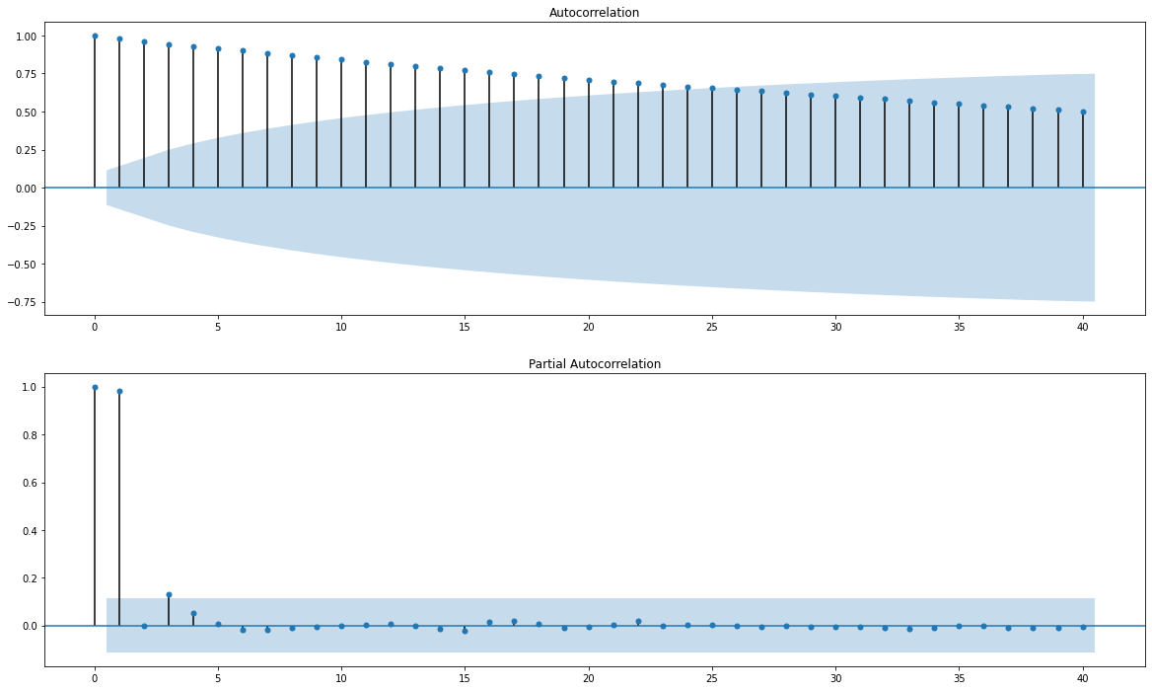
ACF and PACF
Since the dickey fuller test shows the p-value less than 0.5, we plotted the ACF and PACF to find a suitable model to fit in ARMA model.
As we can see ACF value is approximately 25, which not the possible suitable value for the model

Slide 14
Differencing
Differencing is to make a non-stationary time series stationary — compute the differences between consecutive observations.
In order to make the data stationary we have used the first order differencing which given by
y’(t) = y(t) – y(t-1)

Slide 15
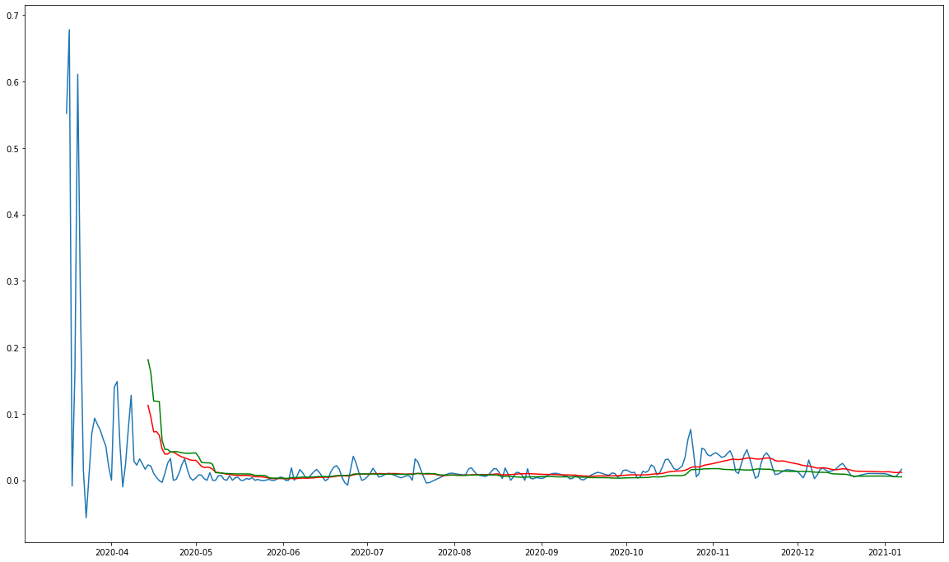

Slide 16
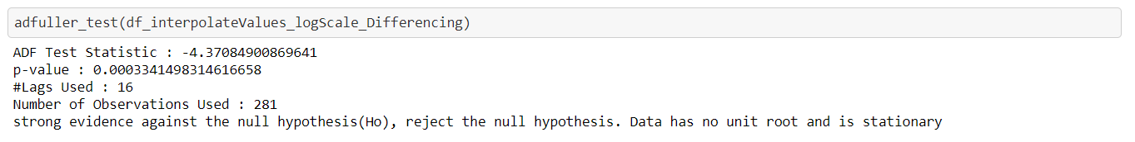
Null Hypothesis check
As we can see P values is much less than 0.05, which makes the data stationary and no unit root in it.

Slide 17
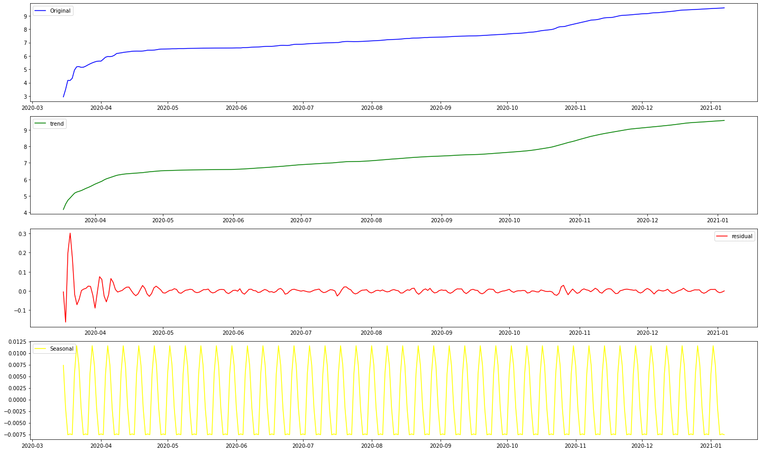
Seasonality check
Though there is no seasonality in the previous the graphs, to be on the safer note we also plotted the seasonality graph as well
Residuals are nothing but the irregularities present in the data

Slide 18
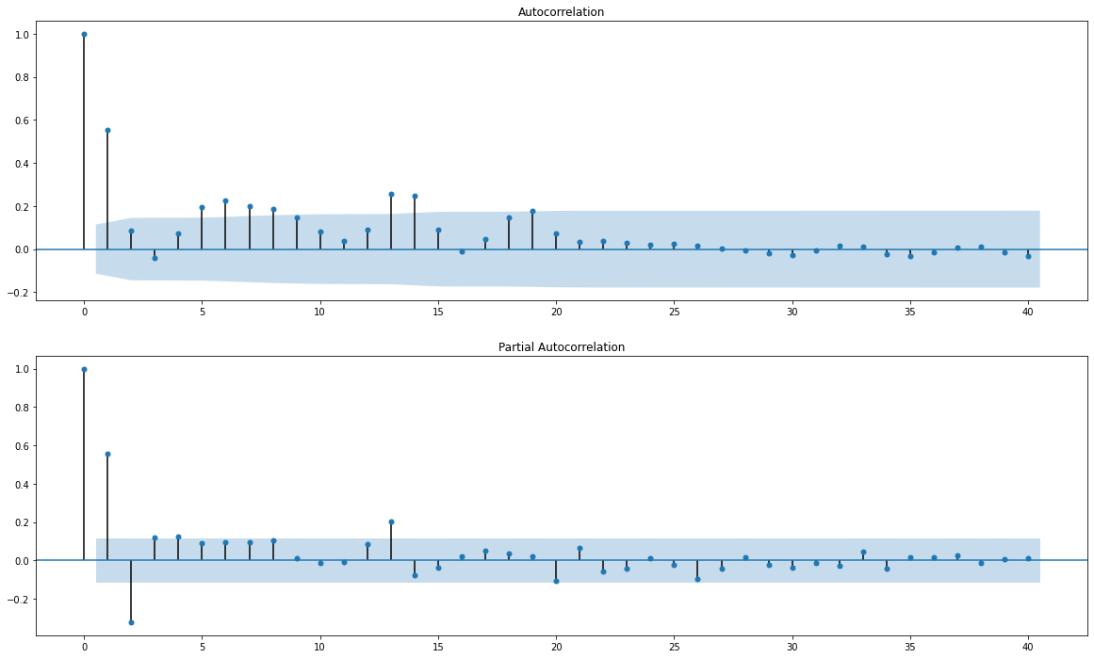
ACF and PACF
As we can see the values of ACF(p) and PACF(q) shut to zero at 2.
We can say that p-2, d-1, and q-2 are best suitable model for the ARIMA

Slide 19
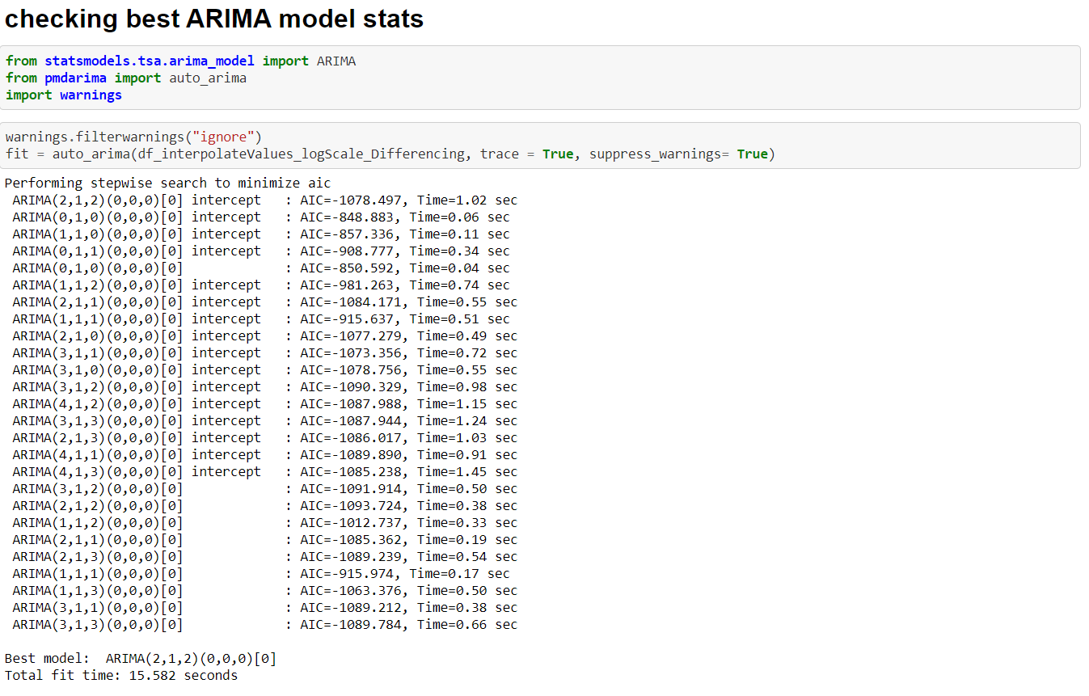
ARIMA
From Statically library Pmdarima we are using auto Arima method to predict the best suitable model from the differencing index
As we can see the model also predicts the similar values of p , d, and q

Slide 20
Cumulative sum and exponentially
Since, we have subtracted moving average from log scale values we are taking cumulative sum to bring back the values to log scale
As, we also took the log scale, to bring back the normal values we are using exponential

Slide 21
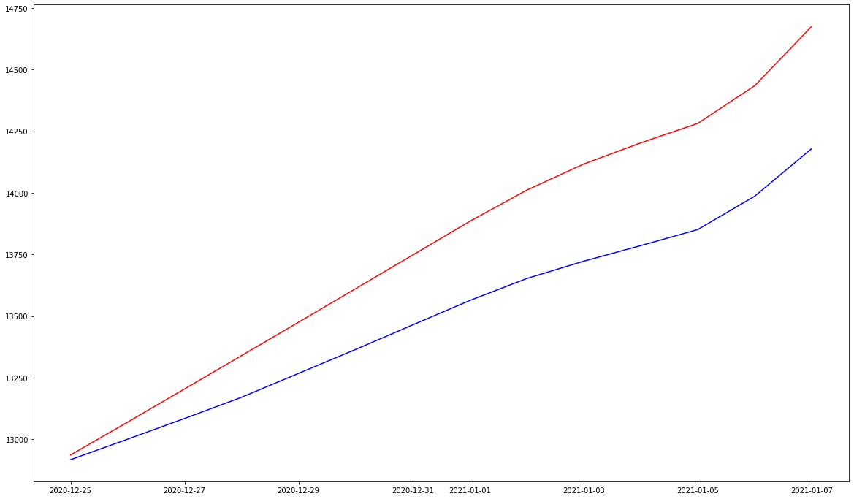
Testing the data
Here we are trained the data for n week and predicting for the n+2 weeks and comparing the same with original data
as we can see the trend is same, but there is difference in the values of estimation andactual

Slide 22
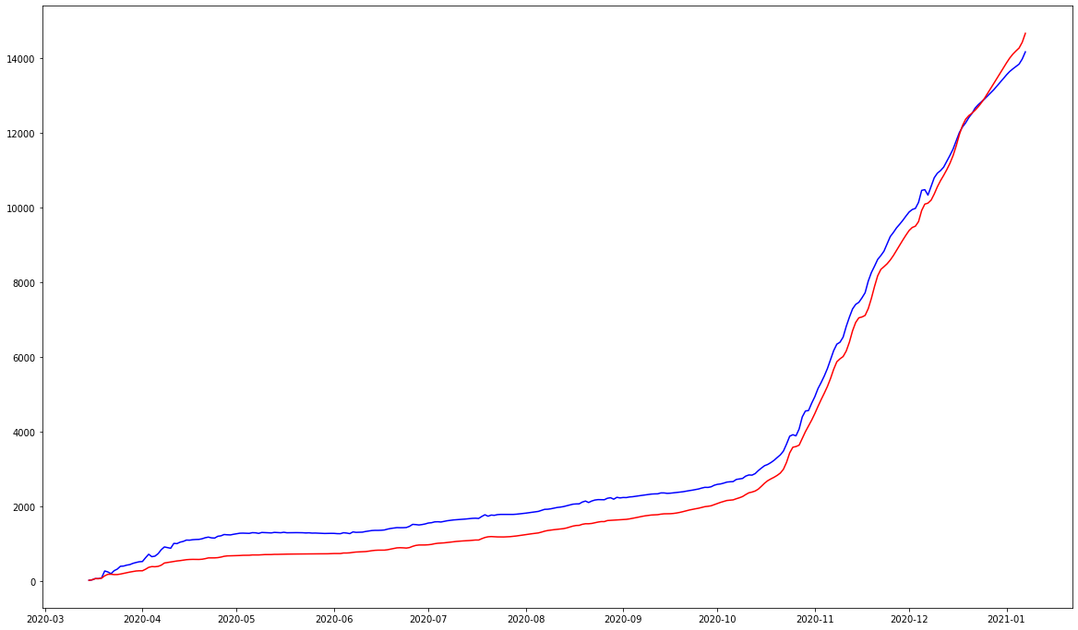
Comparison
Plotting the predicted values with current infection rate for the complete data set
Here we can see the complete trend is almost similar to the actual one

Slide 23
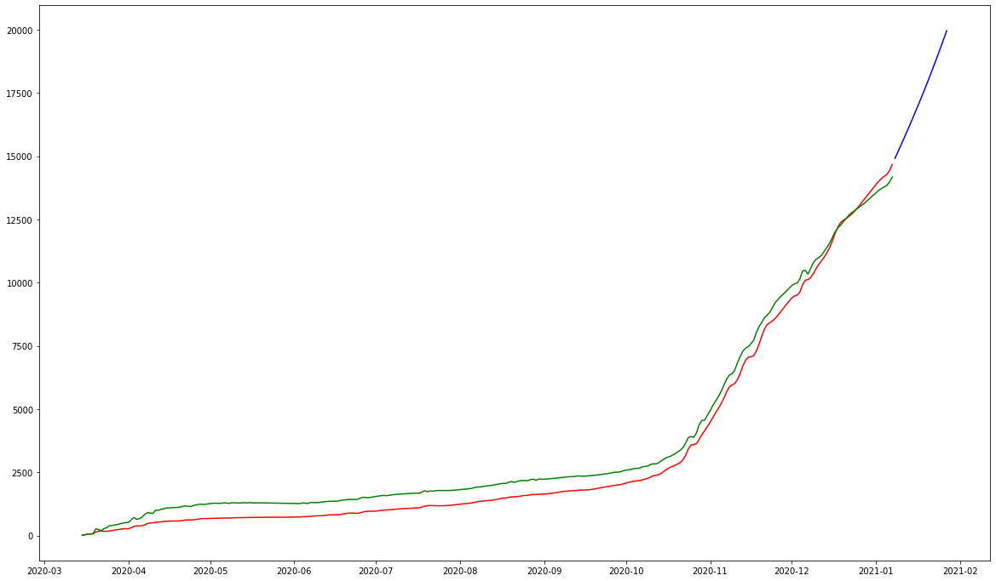
Prediction for the Future
Predicting for the next 20 days

Slide 24
Git Hub
Complete code and dataset used has been uploaded at the below git hub URL:
https://github.com/krupa1106/CoronaVirusPrediction
Please change the location and file name in the second line of the code according to the path of file in your local computer

Slide 25
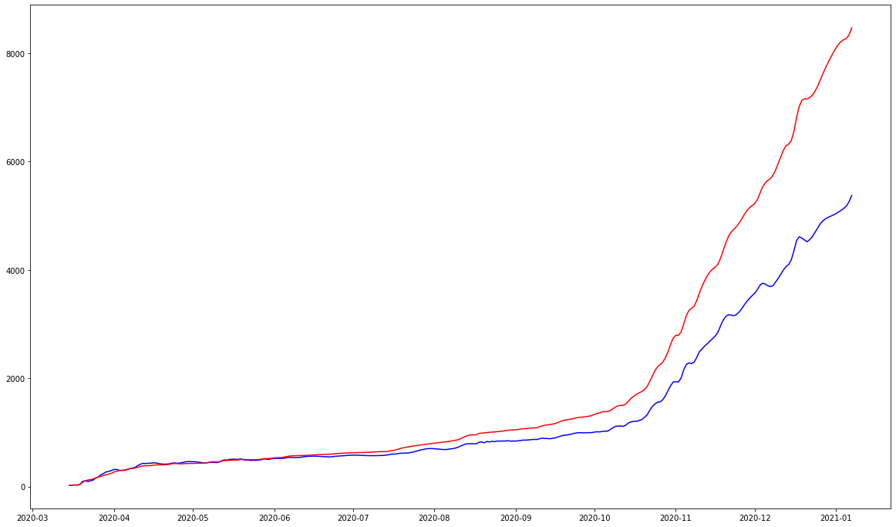
Output for Other cities
Bochum

Slide 26
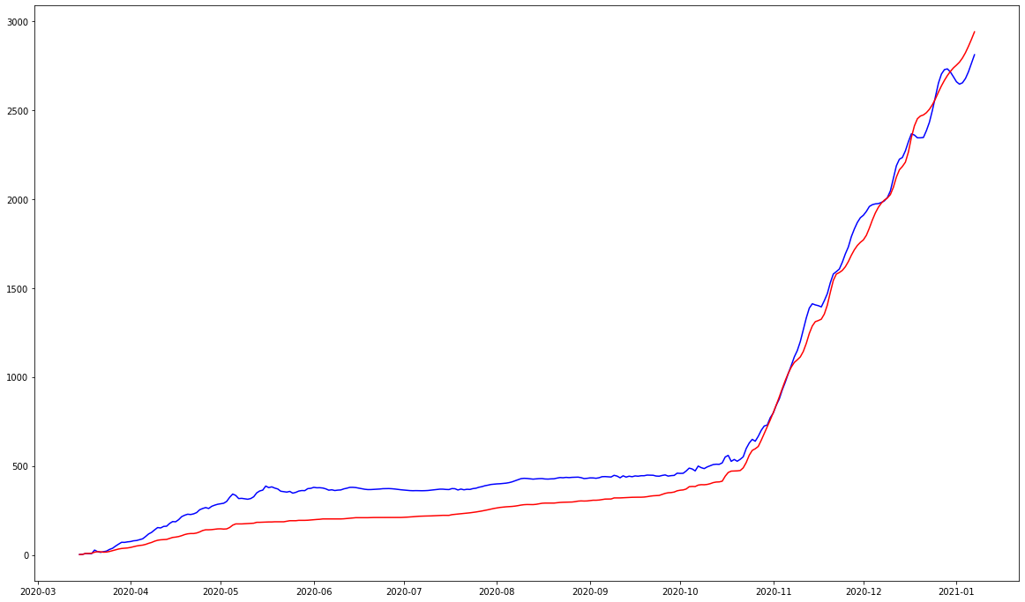
Output for Other cities
Bottrop

Slide 27
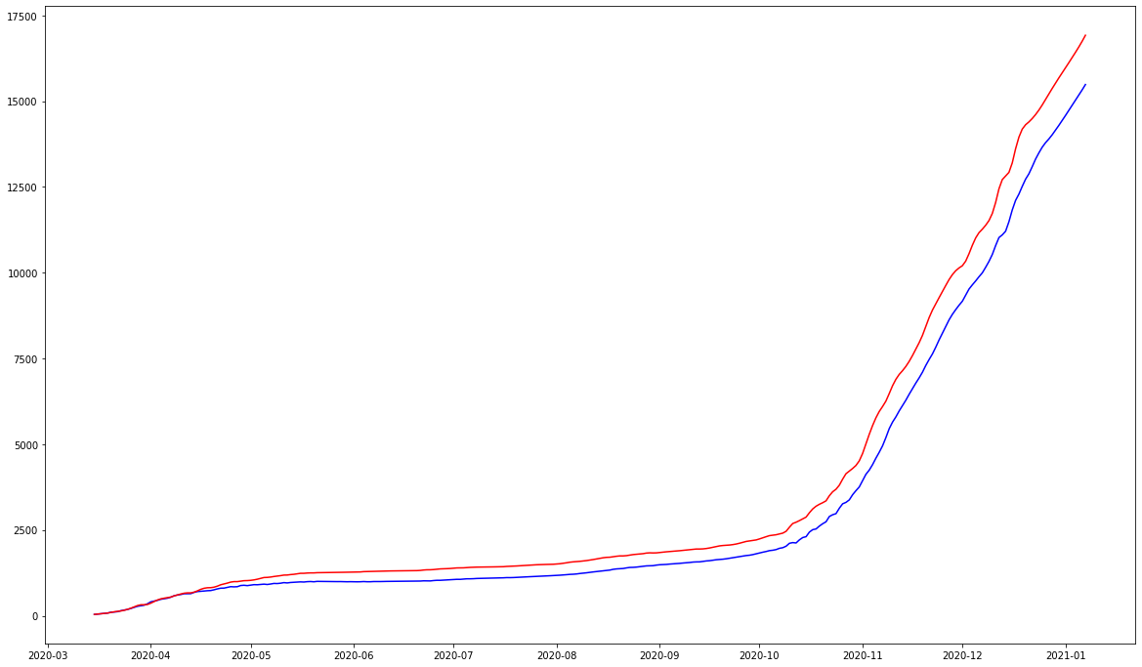
Output for Other cities
Recklinghausen

Slide 28
References
https://otexts.com/fpp2/stationarity.html
https://bit.ly/3vmNXRd
https://bit.ly/3vuLpRl
https://www.machinelearningplus.com/time-series/time-series-analysis-python/
https://towardsdatascience.com/the-complete-guide-to-time-series-analysis-and-forecasting-70d476bfe775

Slide 29

Thank You and belated Happy birthday Corona

